Slide 1
AI and ethics
Stakeholders position
Alexandra Teklak
François Tonglet

Slide 2
Table of contents
01
Risks and challenges of AI
02
Criticisms about the AI Act proposal

Slide 3
Risks and challenges of AI
01

Slide 4
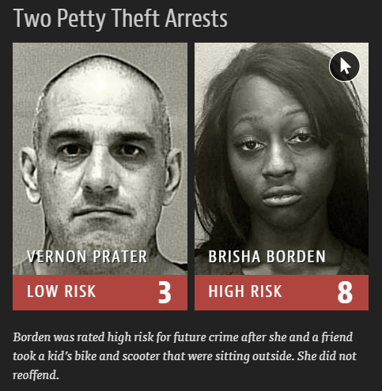
Social risks
Discrimination mainly caused by bias
Example : COMPAS algorithm

Slide 5
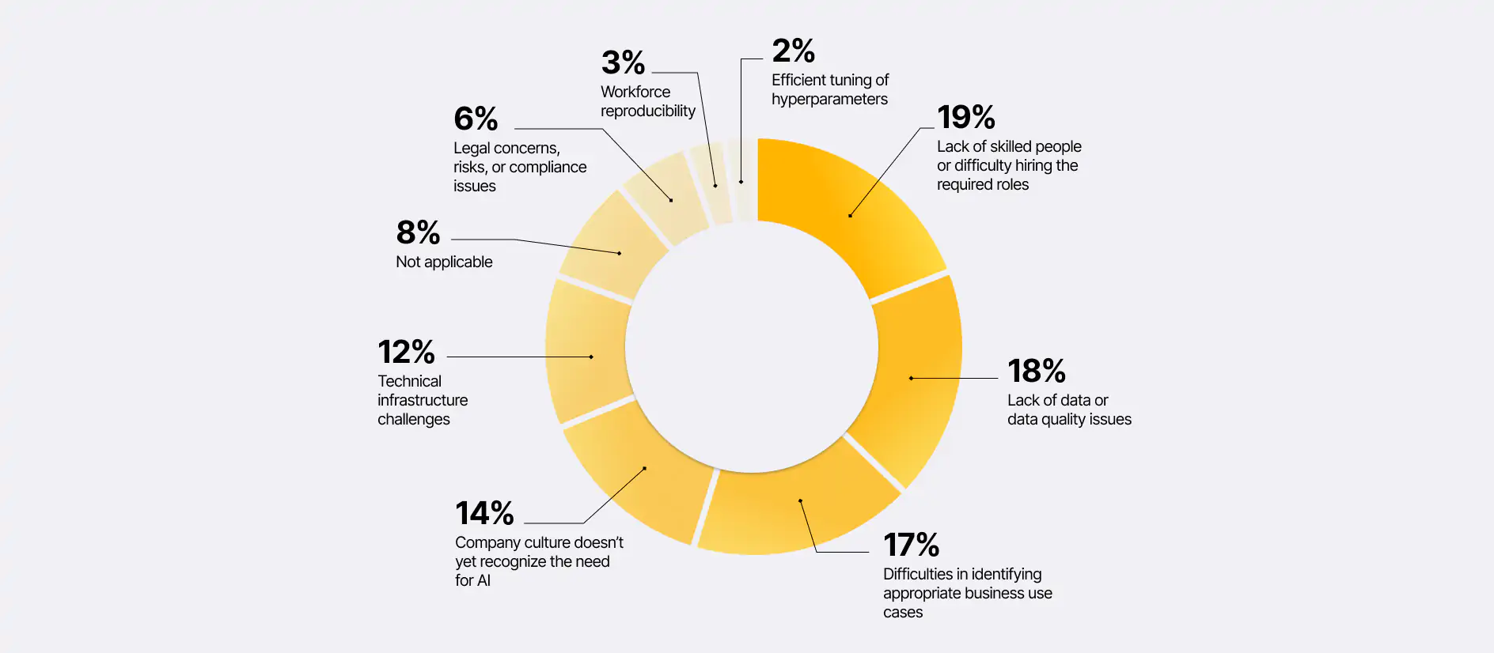
Social risks
Challenges faced by companies that want to adopt AI

Slide 6
2. Technical risks
AI needs a big computing power
"Black box effect"
Data security

Slide 7
3. Financial risks
SME's have fewer resources to develop AI
With AI, powerful multinationals become even more powerful

Slide 8
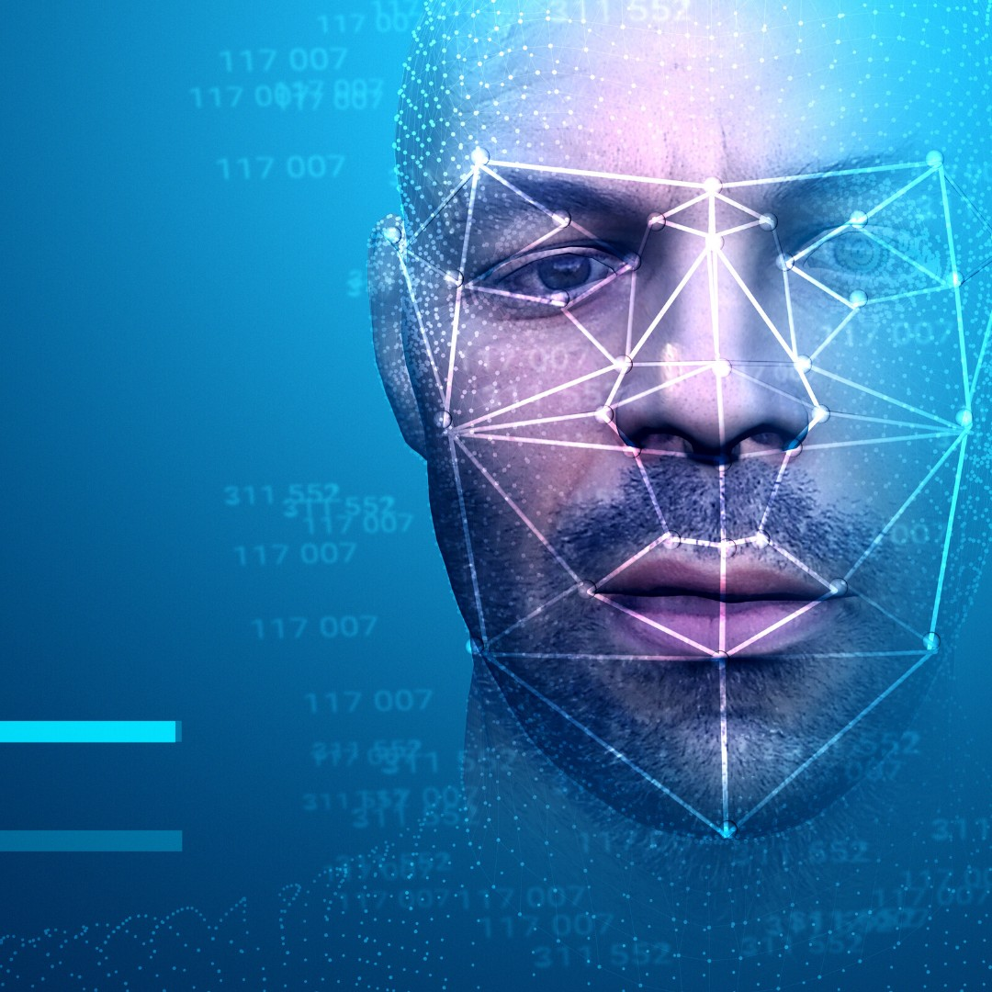
4. Recognition techniques
Mass surveillance and tracking
Target minority groups (// China)
Creation of biometrics databases with our photos. If hacked, risk of harassment or identity theft
In demonstrations, diminish freedom of expression and association
More prone to error when applied to women and people of colour

Slide 9
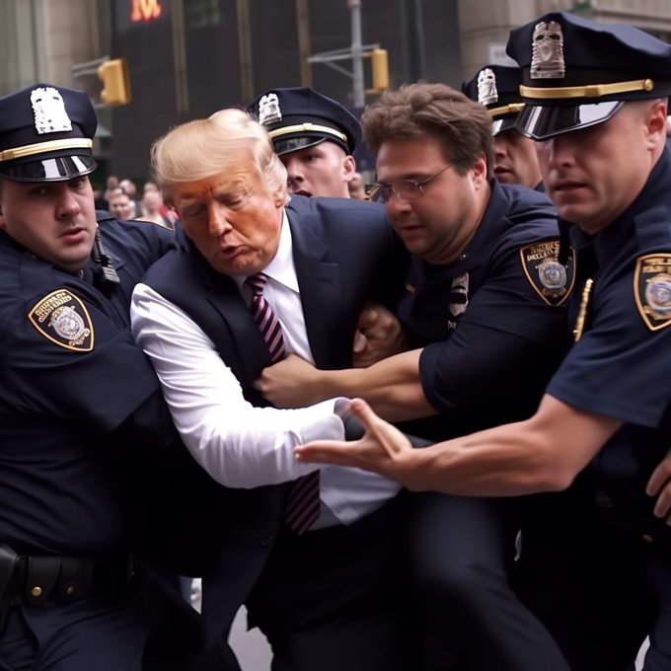
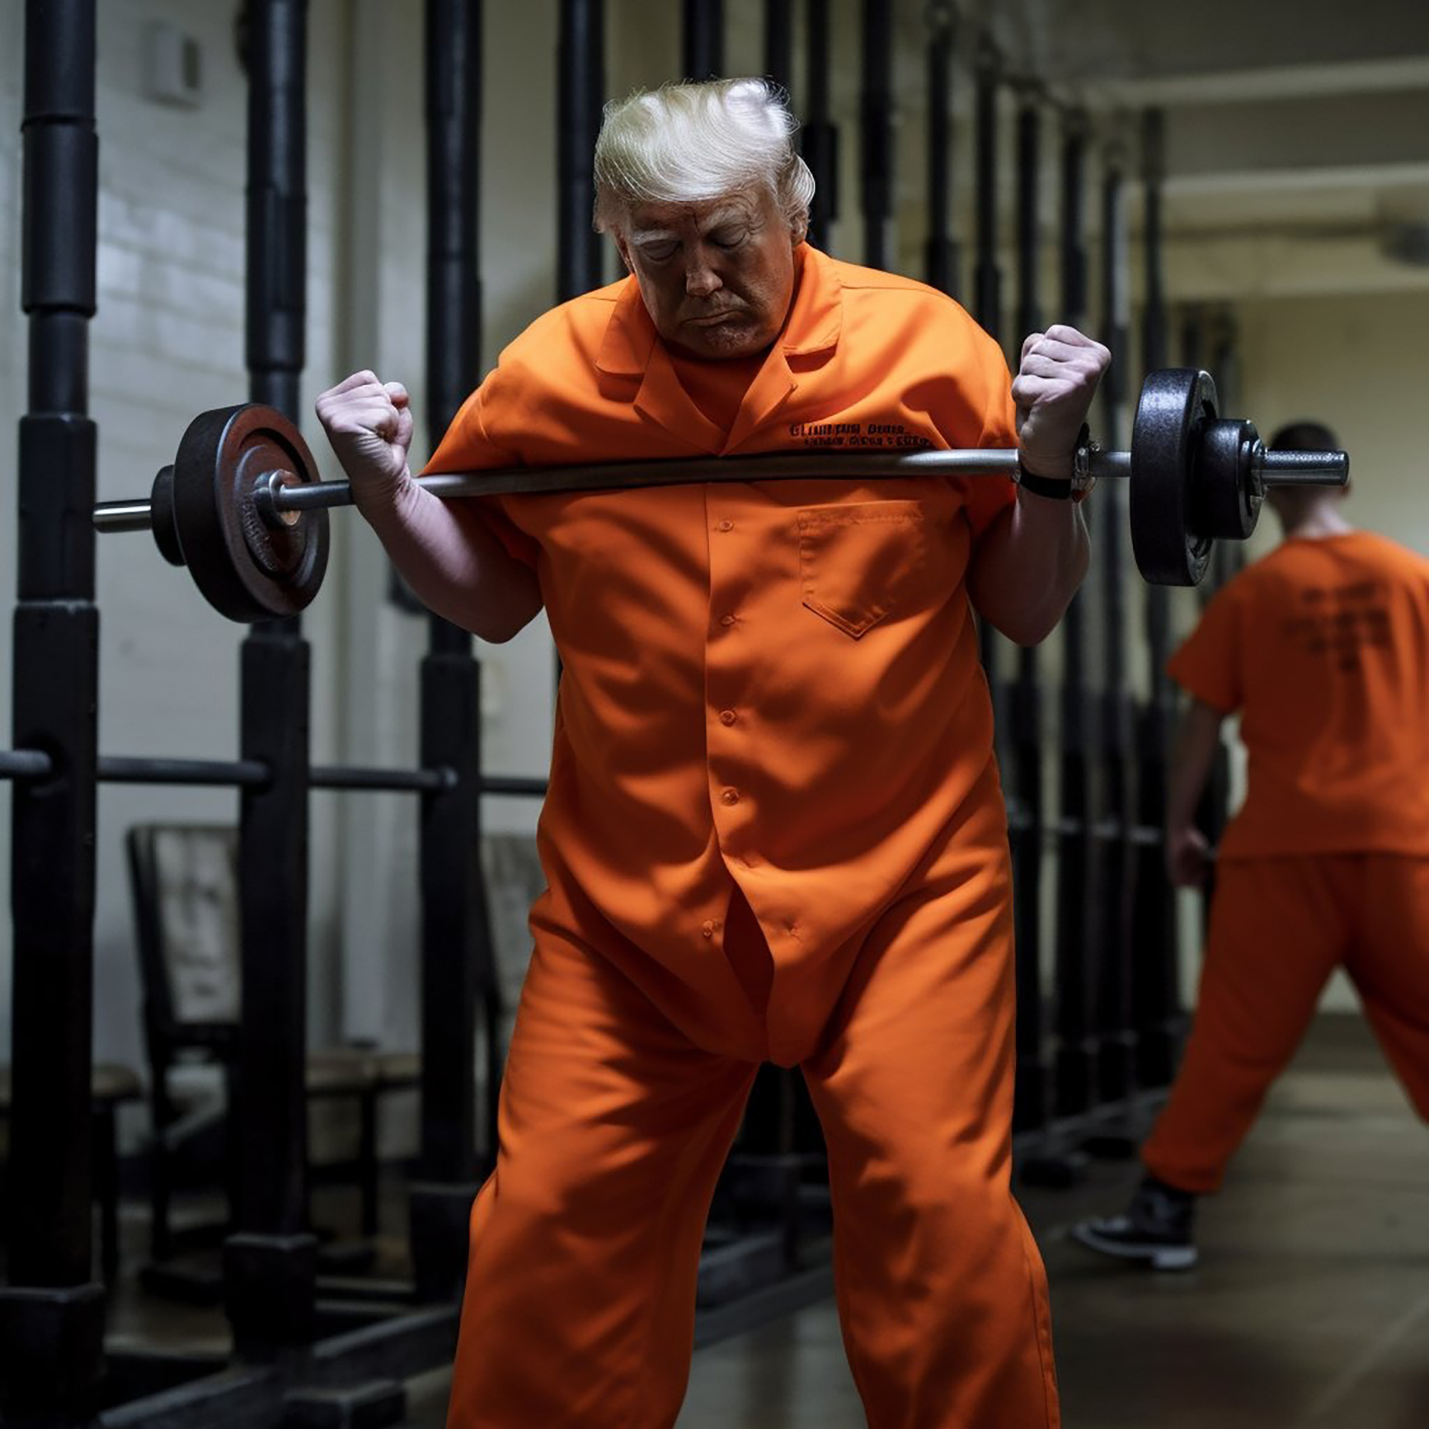
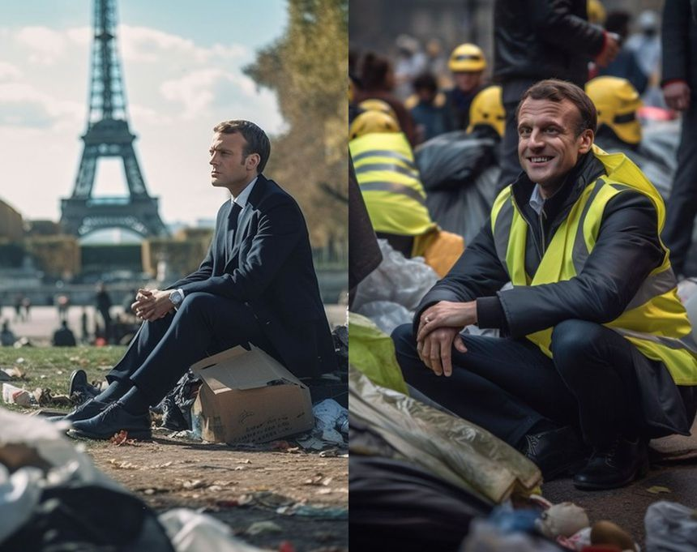
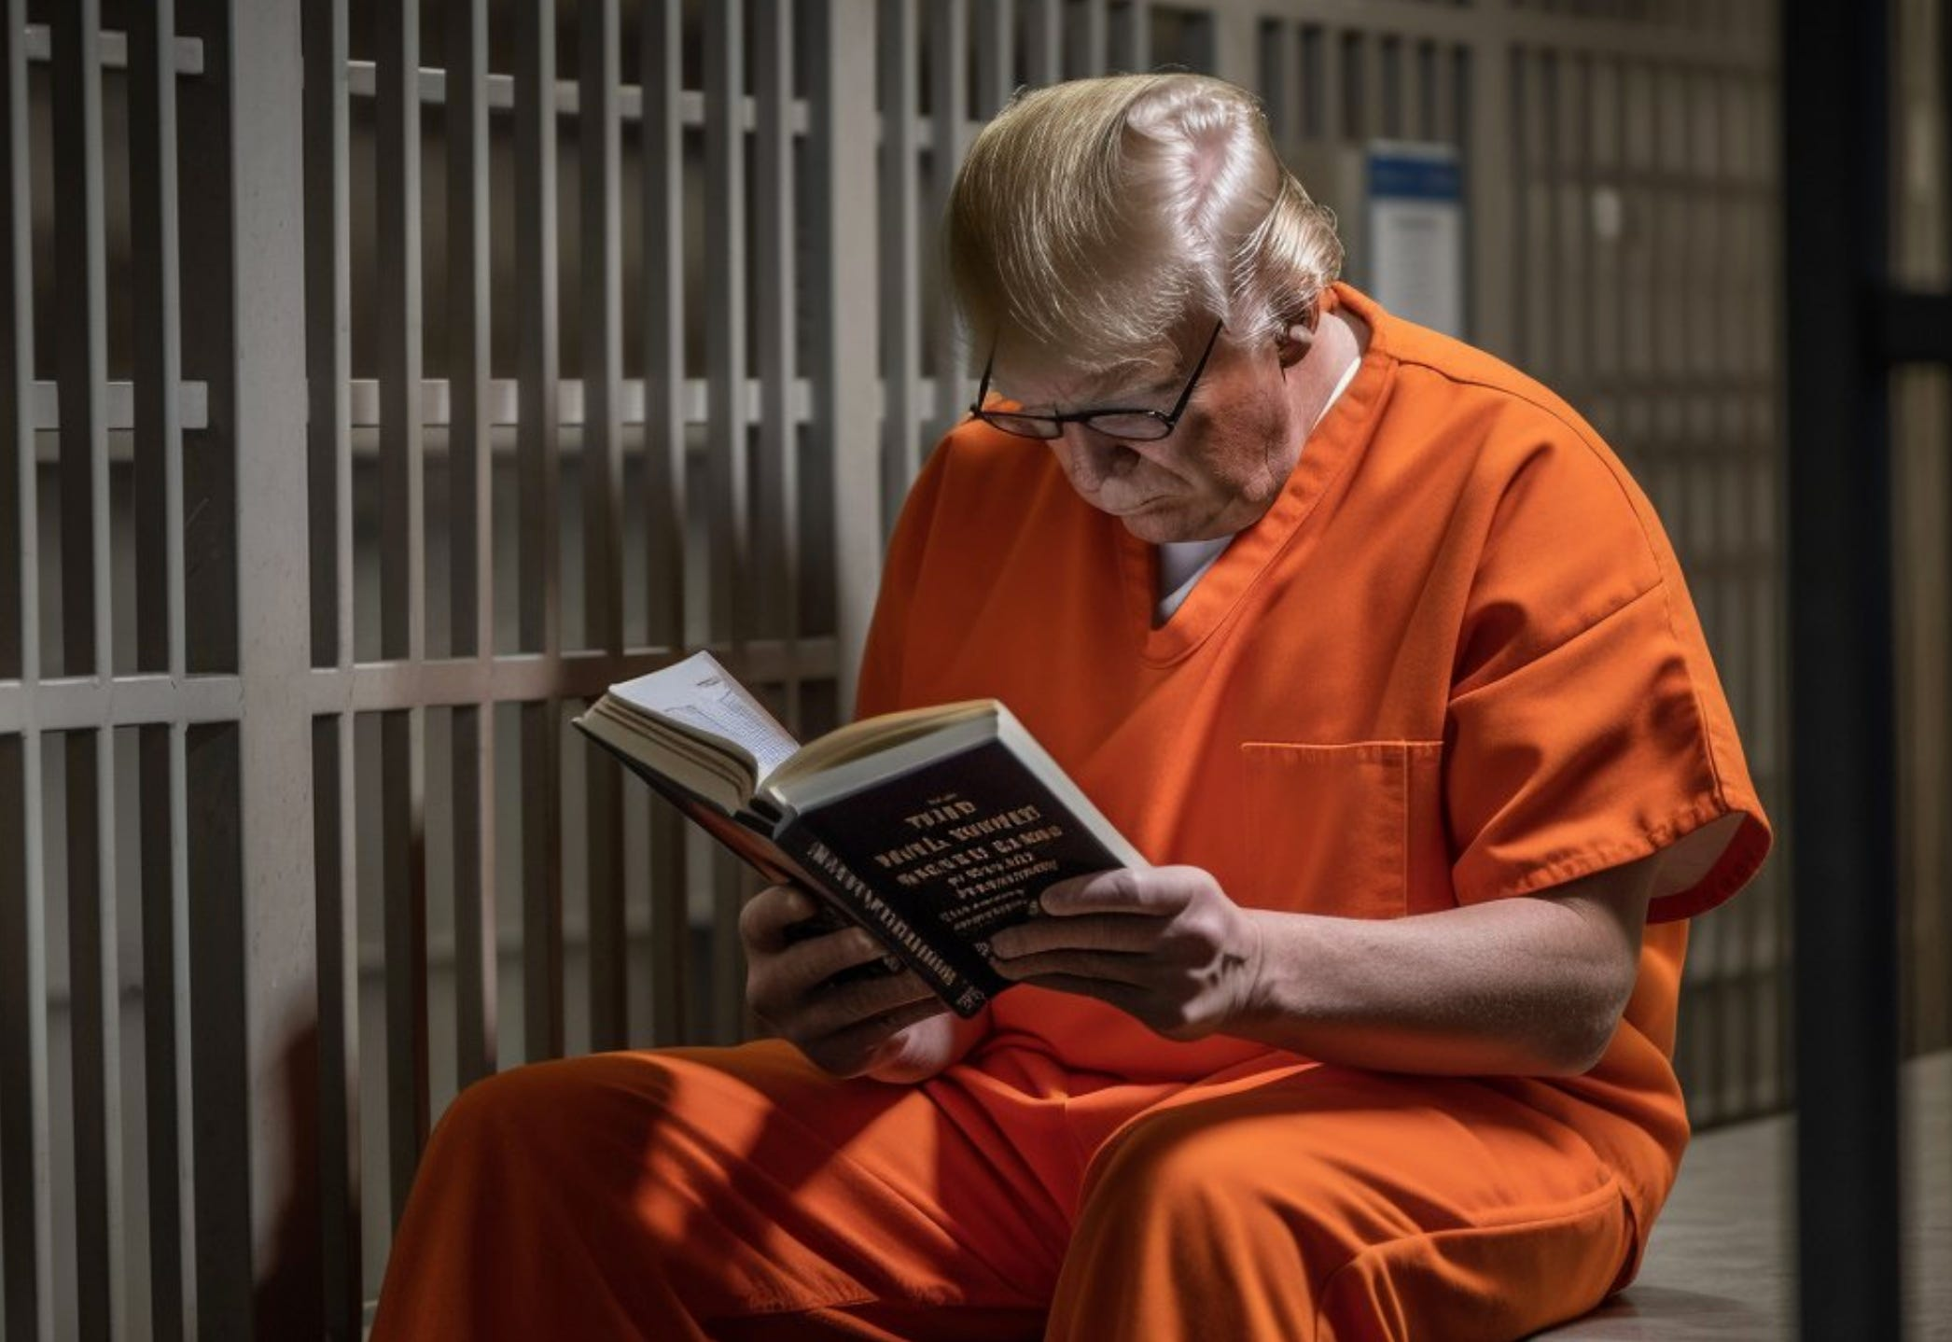
5. Misinformation
Fakes news unintentionally
Deep fakes intentionally

Slide 10
6. Increases unemployment and poverty
Disappearance of several professions
Automated repetitive tasks => labor dependent sectors impacted

Slide 11
02
Criticisms about the AI Act

Slide 12
1. Risk-based approach to be reviewed
Unacceptable systems prohibited
"Intended to distort human behavior, by which physical and psychological damage is likely to occur" => unclear Examples : Facebook, Instagram

Slide 13
Mainly high-risk AI systems impacted Suicide of a Belgian eco-anxious because of an American chatbox The risk ranking system must be reconsidered !
b. Chatbox systems seen as limited risk
!

Slide 14
2. Barrier to innovation
Open source regulation : more responsibility on developers, not companies

Slide 15
3. Impossible requirements
Human unable to check all very large sets
Human unable to understand all the neural networks of AI, too complex

Slide 16
4. SME's concerns
“There is a large reliance on standards coming out of standardisation organisations, which usually have very low SME representation.”
difficulty to conform to the compliance assessments because low representation in the standarisation organisations
compliance costs are very high for SMEs
Annika Linck
European DigitalSME Alliance

Slide 17
5. Company-centric approach
"The fundamental rights concerns, and the concerns about what artificial intelligence technologies could do to our society, and especially to more vulnerable population groups, are not addressed by the AI Act".
The interests of business are being placed above those of citizens.
Big Tech companies could have a huge influence on the outcome of parliamentary deliberations
Alexandra Geese member of the Greens group in the European parliament

Slide 18
6. Articulation between the regulation proposal and the GDPR
Lack of precision
insertion of a reference to the application of texts governing the protection of personal data
The proposal needs to be adapted on several points

Slide 19
7. Unclear definitions
"Facial recognition" is prohibited in real time, but is still possible within a significant time frame under certain conditions...
"unacceptable AI systems" that deploy subliminal components that individuals cannot perceive or that exploit the vulnerabilities of people...
Such language can be seen as an undesirable ambiguity, potentially covering practices that a liberal society should not want to ban

Slide 20
Thanks !

